Slide 1
AI Legal Advisor Project Phase 1: First Review
Presented By
Hashif V S SJC20AD036
Aleena James SJC20AD009
Jomal P Joy SJC20AD043
Priyan V SJC20AD050
Guided By
Ms.Neena Joseph
Assistant Professor
Artificial Intelligence and Data Science Department

Slide 2
Outline
Introduction
Motivation
Problem Statement
Literature Survey
Objective
Methodology
Work Schedule
Conclusion
References

Slide 3
Introduction
In a world marked by ever-increasing legal complexities, access to reliable legal advice is often a privilege. Our project, the “AI Legal Advisor," aims to change that by providing an innovative and user-friendly solution to bridge the gap between individuals and legal professionals.
At the heart of our project is advanced technology, including Large Language Models and extensive legal databases. These tools empower our system to not only understand legal questions but also provide up-to-date and personalized legal guidance.

Slide 4
Motivation
As a civilian legal complexities can affect anyone, irrespective of their background or profession, we believe that access to legal advice should be a universal right. The “AI Legal Advisor" aims to level the playing field, making quality legal guidance available to all.
We understand that legal knowledge is empowering. The project isn't just about providing answers; it's also about educating users. We aim to enhance legal literacy, making individuals better equipped to handle their legal matters.

Slide 5
Problem Statement
Access to reliable legal advice is a fundamental right, yet it remains a privilege for many. In a world marked by escalating legal complexities, individuals often face daunting barriers when seeking legal guidance. The gap between the common citizen and legal professionals is both evident and concerning. As a result, there is an urgent need for an accessible, efficient, and user-friendly system that can bridge this gap and provide individuals with the legal knowledge and support they require.

Slide 6
Literature Review
Title | Authors | Year
Pre-trained Language Models for the Legal Domain: A Case Study on Indian Law | Shounak Paul Arpan Mandal Pawan Goyal Saptarshi Ghosh | 28 June 2023
ChatLaw: Open-Source Legal Large Language Model with Integrated External Knowledge Bases | Jiaxi Cui Zongjian L Yang Yan Bohua Chen Li Yuan | 15 May 2023
Retrieval-Augmented Generation for Knowledge-Intensive NLP Tasks | Patrick Lewis Ethan Perez Aleksandra Piktus Fabio Petroni† Vladimir Karpukhin | 12 Apr 2021

Slide 7
Cont.
Title | Authors | Year
Llama 2: Open Foundation and Fine-Tuned Chat Models | Hugo Touvron Louis Martin Kevin Stone Peter Albert Amjad Almahairi | 19 July 2023

Slide 8
Pre-trained Language Models for the Legal Domain: A Case Study on Indian Law
Investigated Indian legal domain using NLP with Transformer-based PLMs
Retrained LegalBERT and CaseLawBERT, also trained a model from scratch.
Enhanced performance on Indian texts and maintained/improved on European and UK.
Applied to NLP tasks such as Legal Statute Identification, Semantic Segmentation of Court Judgments, and Court Appeal Judgment Prediction.

Slide 9
Cont.
Used masked language model (MLM) objective, where random words in the input are masked, and the model is trained to predict these masked words.
Recognizing the uniqueness of Indian legal language, a custom vocabulary is created for Indian legal documents.
The court cases in the dataset span primarily from 1950 to 2019.
Model performance is evaluated using perplexity metric. It scores the model based on these probabilities.

Slide 10
ChatLaw: Open-Source Legal Large Language Model with Integrated External Knowledge Bases
ChatLaw: Open-source legal large language model.
Combining vector database retrieval with keyword retrieval to mitigate model hallucinations during legal data screening.
Utilized the ChatGPT API for assisted construction to generate supplementary data based on the existing dataset.
Trained a model based on BERT to measure the similarity between users' language and a dataset of 930,000 relevant legal case texts.

Slide 11
Cont.
Developed a set of multiple-choice questions specifically designed for the bar exam.
Trained different models for various scenarios, including multiple-choice questions, keyword extraction, and question-answering.
Addressing errors in reference data and improving problem-solving capabilities.
The noted suboptimal results when user questions are vague is a significant drawback.

Slide 12
Retrieval-Augmented Generation for Knowledge-Intensive NLP Tasks
Pre-trained models struggle with precise knowledge handling, lacking provenance and updates.
RAG approach endows pre-trained, parametric-memory generation models with a non-parametric memory.
Parametric memory refers to the memory component in a neural network that is learned and stored in the model parameters during training.
The generator component based on a pre-trained seq2seq transformer like BART serves as the parametric memory.

Slide 13
Cont.
Non-parametric memory involves an external memory source that is not part of the neural network parameters. It remains fixed or is updated separately from the model training process.
The retriever component, such as DPR, provides the non-parametric memory in the form of a dense vector index of external knowledge sources, such as Wikipedia.
RAG-Sequence uses the same document throughout the generation process, simplifying the decoding procedure but potentially limiting diversity.
RAG-Token allows different latent documents for each target token, promoting diversity but requiring more complex decoding.

Slide 14
Llama 2: Open Foundation and Fine-Tuned Chat Models
Llama 2 models are optimized for dialogue use cases and outperform open-source chat models.
The paper provides guidelines for safe and helpful model responses.
The paper describes a multi-step assessment process for selecting annotators.
The paper presents a novel approach called RLHF for learning from human feedback.
The paper provides a strategy for responsibly releasing these models.

Slide 15
Objective
Our foremost objective is to create a chatbot-based "Intelligent Legal Advisor" that brings legal consultations into everyday conversations. We aim to make legal advice as accessible as chatting with a friend, breaking down the barriers of legal complexities.
The chatbot implementation will focus on providing personalized, up-to-date legal guidance. By considering the user's specific legal query, jurisdiction, and context, our system ensures a tailored experience, enhancing legal literacy and empowering users.

Slide 16
Methodology
Part 1: Pretraining and Fine-Tuning
We start with pre-training the model from scratch using court judgements and Government acts, allowing it to learn general law language understanding and generation skills.
We fine tune the pretrained model on 2 legal tasks with Indian datasets.
Multi-label Text Classification: Identifying relevant statutes (law articles) based on the facts of a court case
Binary Text Classification: Predicting whether the claims/petitions of a court case will be accepted/rejected

Slide 17
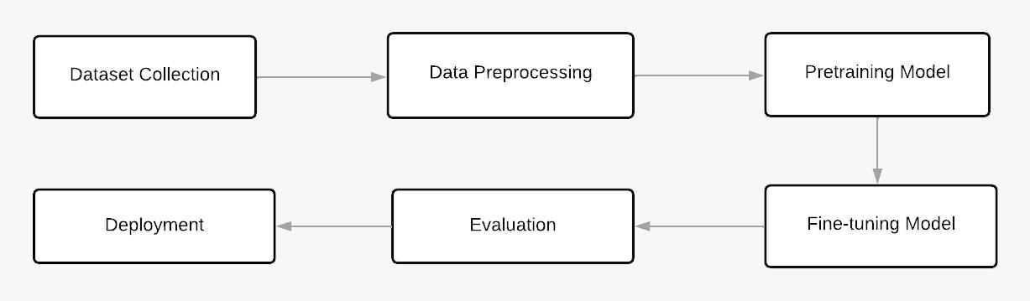
Cont.

Slide 18
Cont.
Part 2: Retrieval-Augmented Generation (RAG) with Legal Prompts
We propose a RAG supported system so that users can be aided with their research on the case documents.
We implement Retrieval-Augmented Generation (RAG) techniques, using frameworks like Langchain and vector databases which enable the chatbot to retrieve information from additional knowledge base provided by the user during conversations.
This integration ensures that the chatbot's responses are not only generated but also retrieved from up-to-date legal resources

Slide 19
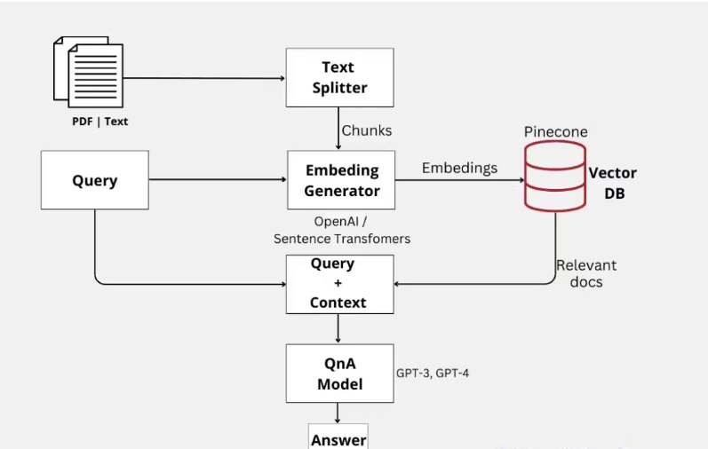
Cont.

Slide 20
Dataset Preparation
Work Done So Far
Scraped case judgments data from online public repository ‘Indian Kanoon’.
The files collected are supreme court judgements from 2021 to 2023
Currently collected over 2000 Judgments.

Slide 21
Cont.
ILSI(Indian Legal Statute Identification) Dataset
Large novel dataset that includes facts of cases from several major Indian Courts of Law, and statutes from the Indian Penal Code (IPC).
Data is modelled as a heterogeneous graph. This to be used for fine-tuning the model for Identifying relevant statutes(law articles) based on the facts of a court case.
Captures the multi-label nature of the LSI problem.

Slide 22
Cont.
ILDC (Indian Legal Documents Corpus)
ILDC is a collection of English case proceedings from the Supreme Court of India (SCI). A portion of the corpus (a separate test set) is annotated with gold standard explanations by legal experts.
Each document is labeled with the judge's decision (accepted or rejected) serving as gold labels.
ILDCsingle has documents with a single petition or multiple petitions with identical decisions.ILDCmulti is a superset including cases with multiple petitions leading to different decisions.

Slide 23
Cont.
Implemented a RAG model and Chatbot Interface
Used llama-2-70b-chat model and GPT-3.5 Turbo models through API calls.
Implemented RAG on documents like Indian-penal code and Indiancivillaw using langchain framework.
Build an interactive chatbot interface using streamlit framework.

Slide 24
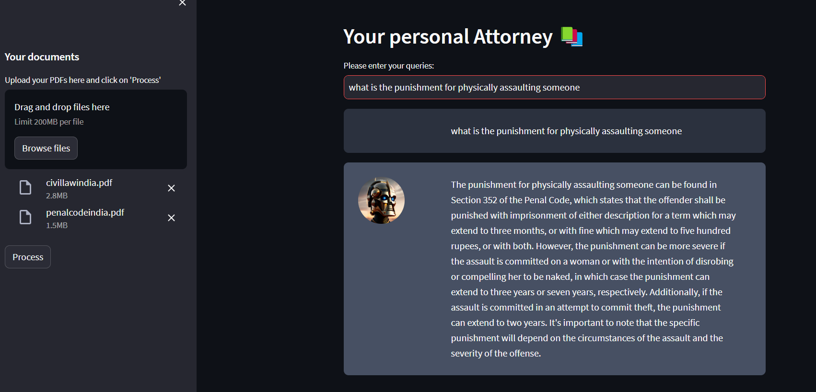
Cont.

Slide 25
Conclusion
The "Intelligent Legal Advisor" represents a significant step forward in the accessibility of legal advice. By leveraging advanced technologies, a rich dataset, and thoughtful prompt engineering, we've developed a chatbot that is set to make a real impact in the legal world.
Our system empowers individuals with personalized, secure, and user-friendly legal guidance, while also focusing on enhancing legal literacy. We're excited about the potential of this project and the positive changes it can bring to the legal landscape.

Slide 26
References
[1] Payal Bajaj, Daniel Campos, Nick Craswell, Li Deng, Jianfeng Gao, Xiaodong Liu, Rangan Majumder, Andrew McNamara, Bhaskar Mitra, Tri Nguyen, Mir Rosenberg, Xia Song, Alina Stoica, Saurabh Tiwary, and Tong Wang. MS MARCO: A Human Generated MAchine Reading COmprehension Dataset. arXiv:1611.09268 [cs], November 2016. URL http: //arxiv.org/abs/1611.09268. arXiv: 1611.09268.
[2] Iz Beltagy, Matthew E. Peters, and Arman Cohan. 2020. Longformer: The Long-Document Transformer. arXiv:2004.05150 (2020)
[3] Christopher Clark and Matt Gardner. Simple and Effective Multi-Paragraph Reading Comprehension. arXiv:1710.10723 [cs], October 2017. URL http://arxiv.org/abs/1710.10723. arXiv: 1710.10723.
[4] Angela Fan, Claire Gardent, Chloe Braud, and Antoine Bordes. Augmenting transformers with KNN-based composite memory, 2020. URL https://openreview.net/forum?id= H1gx1CNKPH.
[5] Paheli Bhattacharya, Shounak Paul, Kripabandhu Ghosh, Saptarshi Ghosh, and Adam Wyner. 2021. DeepRhole: deep learning for rhetorical role labeling of sentences in legal case documents. Artificial Intelligence and Law (11 2021), 1–38
[6] Ilias Chalkidis et al . 2022. LexGLUE: A Benchmark Dataset for Legal Language Understanding in English. In Proc. of ACL .
[7] Ilias Chalkidis, Ion Androutsopoulos, and Nikolaos Aletras. 2019. Neural Legal Judgment Prediction in English. In Proc. of ACL .

Slide 27
Cont.
[8] LeSICiN: A Heterogeneous Graph-based Approach for Automatic Legal Statute Identification from Indian Legal Documents Shounak Paul, Pawan Goyal, Saptarshi Ghosh.arXiv:2112.14731v1 [cs.CL] 29 Dec 2021
[9] IIITH-ILSC Speech Database for Indian Language Identification Ravi Kumar Vuddagiri, Krishna Gurugubelli, Priyam Jain, Hari Krishna Vydana, Anil Kumar Vuppala 6th Workshop on Spoken Language Technologies for Under-Resourced Languages (SLTU 2018) 29-31 August 2018, Gurugram, India.
[10] https://paperswithcode.com/dataset/ildc
[11] F. Richardson, D. Reynolds, and N. Dehak, “A unified deep neu-
ral network for speaker and language recognition,” arXiv preprint
arXiv:1504.00923, 2015.

Slide 28
THANK YOU

Slide 29
QUESTIONS?

